Slide 2
5 TYPES OF
CONFLICT STYLES

Slide 3
CONFLICT
The condition in which two or more individual’s concerns appear to be incompatible

Slide 4
CONFLICT is a natural and healthy part of human personal and professional relationships.

Slide 5
CONFLICT is a natural and healthy part of human personal and professional relationships.
CONFLICT becomes unhealthy when it is handled in an unproductive manner

Slide 6
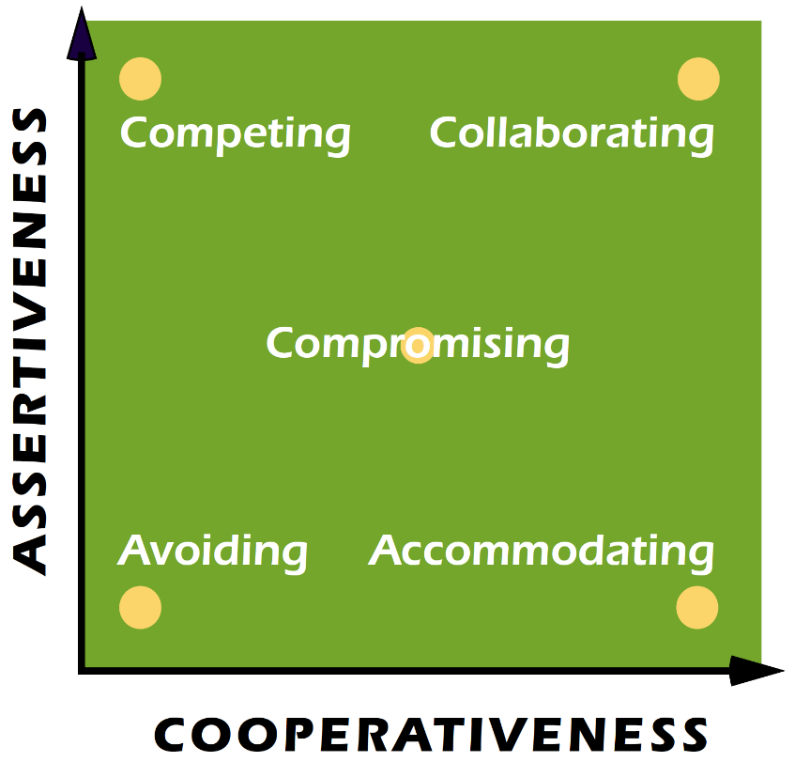
Thomas-Kilmann Conflict
Mode Instrument

Slide 7
Thomas-Kilmann Conflict
Mode Instrument
ASSERTIVENESS the degree to which you try to satisfy your own concerns during conflict

Slide 8
Thomas-Kilmann Conflict
Mode Instrument
ASSERTIVENESS the degree to which you try to satisfy your own concerns during conflict
COOPERATIVENESS the degree to which you try to satisfy the other individuals’ concerns during conflict

Slide 9
Thomas-Kilmann Conflict
Mode Instrument
ASSERTIVENESS the degree to which you try to satisfy your own concerns during conflict
COOPERATIVENESS the degree to which you try to satisfy the other individuals’ concerns during conflict

Slide 10
5 Types of Conflict Styles
Competing
Collaborating
Compromising
Avoiding
Accommodating

Slide 11
COMPETING

Slide 12

COMPETING

Slide 13
COMPETING
“Might makes right”
Assertive & uncooperative, power-oriented mode to win his/her position
Standing up for your rights, defending a position you believe is correct, or simply trying to win

Slide 14
COMPETING
Benefits (USE VERY SPARINGLY!):
  Required to make unpopular decisions (budget cuts or terminating employment)
  Emergency situations (time is of the essence)

Slide 15
COMPETING
Benefits (USE VERY SPARINGLY!):
  Required to make unpopular decisions (budget cuts or terminating employment)
  Emergency situations (time is of the essence)
Costs:
  Strained work relationships
  Decreased initiative and motivation

Slide 16
COLLABORATING

Slide 17
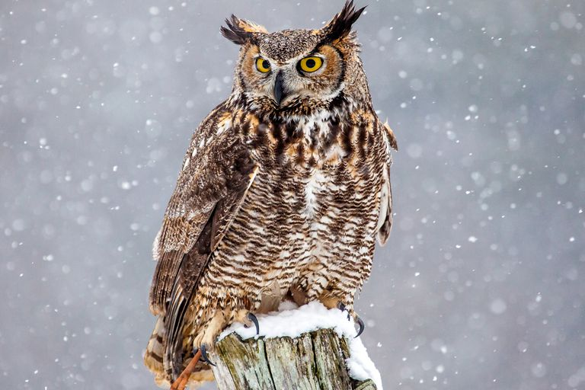
COLLABORATING

Slide 18
COLLABORATING
“Two heads are better than one”
Works to find a solution that fully satisfies the concerns of both
Learns from the other’s insights and tries to find a creative solution

Slide 19
COLLABORATING
Benefits:
  High-quality decisions
  Learning and communication
  Strengthens relationships

Slide 20
COLLABORATING
Benefits:
  High-quality decisions
  Learning and communication
  Strengthens relationships
Costs:
  Time and energy required
  Psychological demands (open to new views)

Slide 21
COMPROMISING

Slide 22
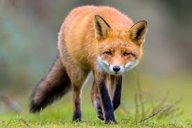
COMPROMISING

Slide 23
COMPROMISING
“Split the difference”
Find an expedient, mutually acceptable solution that partially satisfies both parties
Best suited for issues of intermediate importance

Slide 24
COMPROMISING
Benefits:
  Speed and expediency
  Fairness
  Maintaining relationships – meeting halfway

Slide 25
COMPROMISING
Benefits:
  Speed and expediency
  Fairness
  Maintaining relationships – meeting halfway
Costs:
  Suboptimal decisions
  Partially sacrificed concerns

Slide 26
AVOIDING

Slide 27
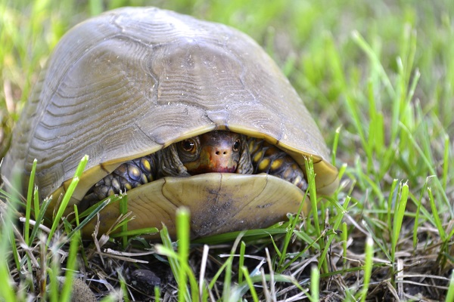
AVOIDING

Slide 28
AVOIDING
“Leave well enough alone”
Individual does not pursue his/her own concerns OR those of the other person
Does not address the conflict (sidestepping, postponing, withdrawing)

Slide 29
AVOIDING
Benefits:
  Reducing stress (for the time being)
  Steering clear of danger
  Setting up more favorable conditions

Slide 30
AVOIDING
Benefits:
  Reducing stress (for the time being)
  Steering clear of danger
  Setting up more favorable conditions
Costs:
  Declining working relationships
  Resentment, delays, and degrading decisions

Slide 31
ACCOMMODATING

Slide 32
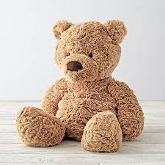
ACCOMMODATING

Slide 33
ACCOMMODATING
“Kill your enemies with kindness”
Individual neglects his/her concerns to satisfy the concerns of the other person
Self-sacrifice or yielding to another’s point of view

Slide 34
ACCOMMODATING
Benefits:
  Restoring harmony & building relationships
  Choosing a quick ending

Slide 35
ACCOMMODATING
Benefits:
  Restoring harmony & building relationships
  Choosing a quick ending
Costs:
  Sacrificed concerns
  Loss of respect
  Loss of motivation

Slide 36
5 Types of Conflict Styles
Each of us is capable of using all FIVE conflict styles. We use some better than others and therefore tend to rely on those styles.

Slide 37
5 Types of Conflict Styles
What is your primary conflict style and why?

Slide 38
5 Types of Conflict Styles
What is your primary conflict style and why?
Which conflict style would you like to grow in? Why and how?

Slide 39
QUESTIONS?

Slide 40


Resources
CG Support
www.cgsuprt.com
855-CG SUPRT
Counseling
Financial
Health
Legal
Personal Growth
Chaplain
Jonathan Alexander
m: 202-774-8788
Jonathan.W.Alexander@
uscg.mil

